Slide 1

Rockbuster Stealth LLC Database Findings
Presentation for business managers

Slide 2
Key Questions & Objectives

Slide 3
Which movies contributed the most/least to revenue gain?
Visualization Link:
https://public.tableau.com/app/profile/olivia.murphy7831/viz/RockbusterRevenuebyFilmTitle/Revenuebyfilmtitle
275 films are not generating any revenue*
*Please see Appendix I for a list of all films generating no revenue

Slide 4
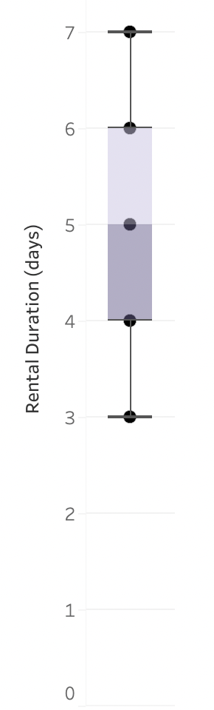
What was the average rental duration for all videos?
T
5 days
Rental Duration:
Rockbuster Stealth LLC Films

Slide 5
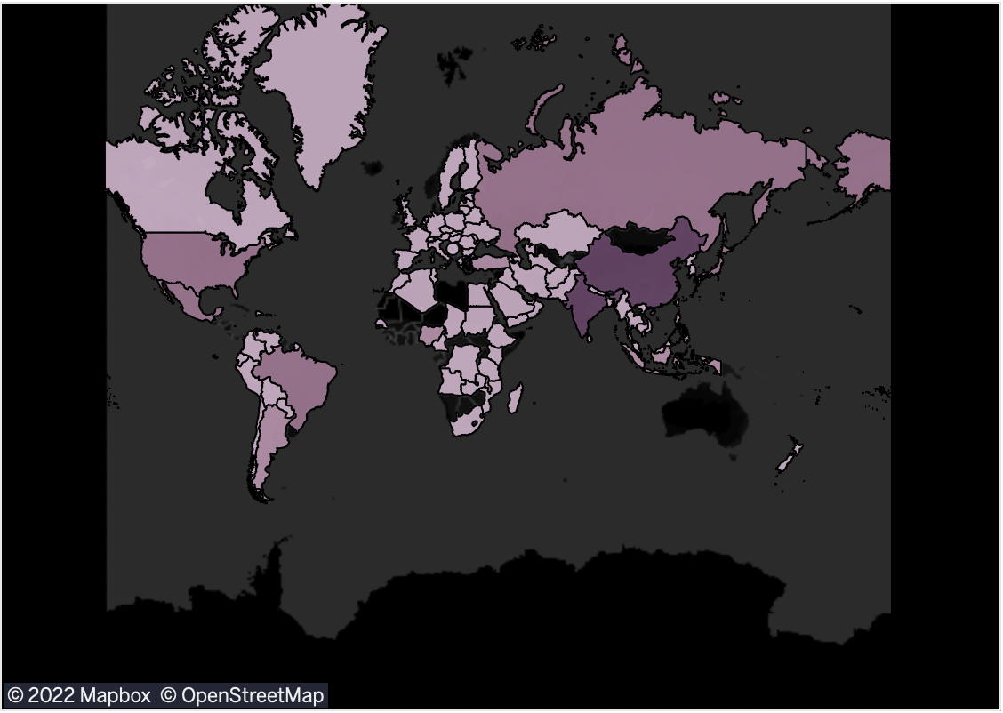
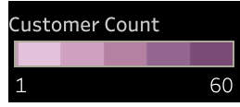
Which countries are Rockbuster customers based in?
Rockbuster customers are based across 108 different countries*
Countries with Rockbuster Stealth Customers
*see Appendix I for a full list of countries Rockbuster customers are based in

Slide 6
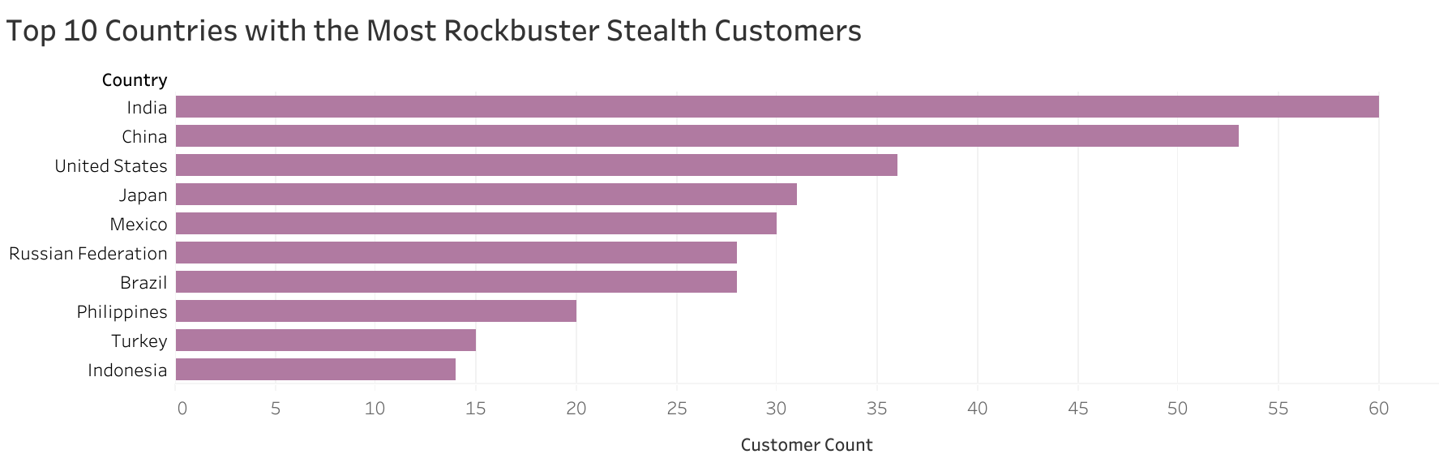

Slide 7
Where are customers with a high lifetime value based?
There is only a 3-month difference between the oldest & most recent payment dates. All accounts were created in 2006.
More information about this database is needed to sufficiently answer this question, as there is not a significant difference in how old the accounts are.

Slide 8
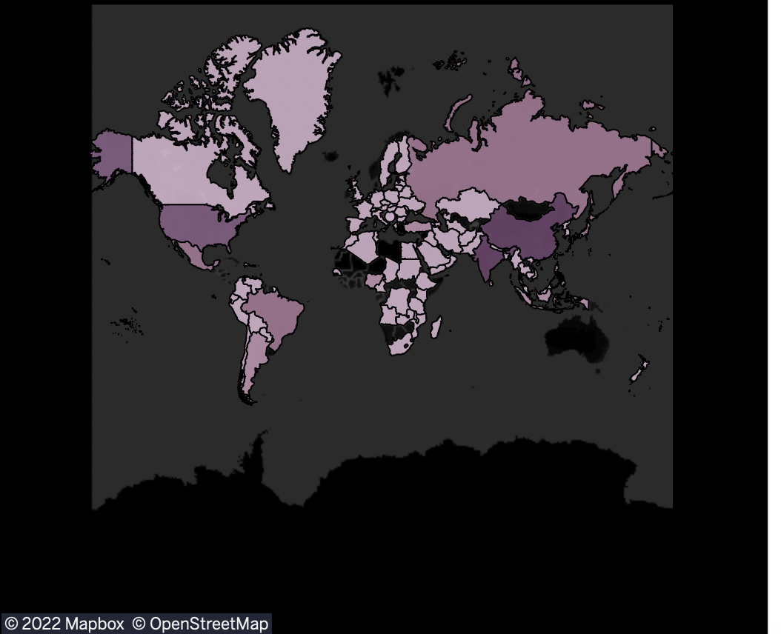
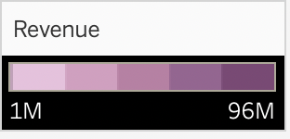
Do sales figures vary between geographic regions?
Yes, revenue varies by geographic region.
On the country level, revenue varies from about $1M to $96M
Revenue by Country: Rockbuster Stealth Film Rentals

Slide 9
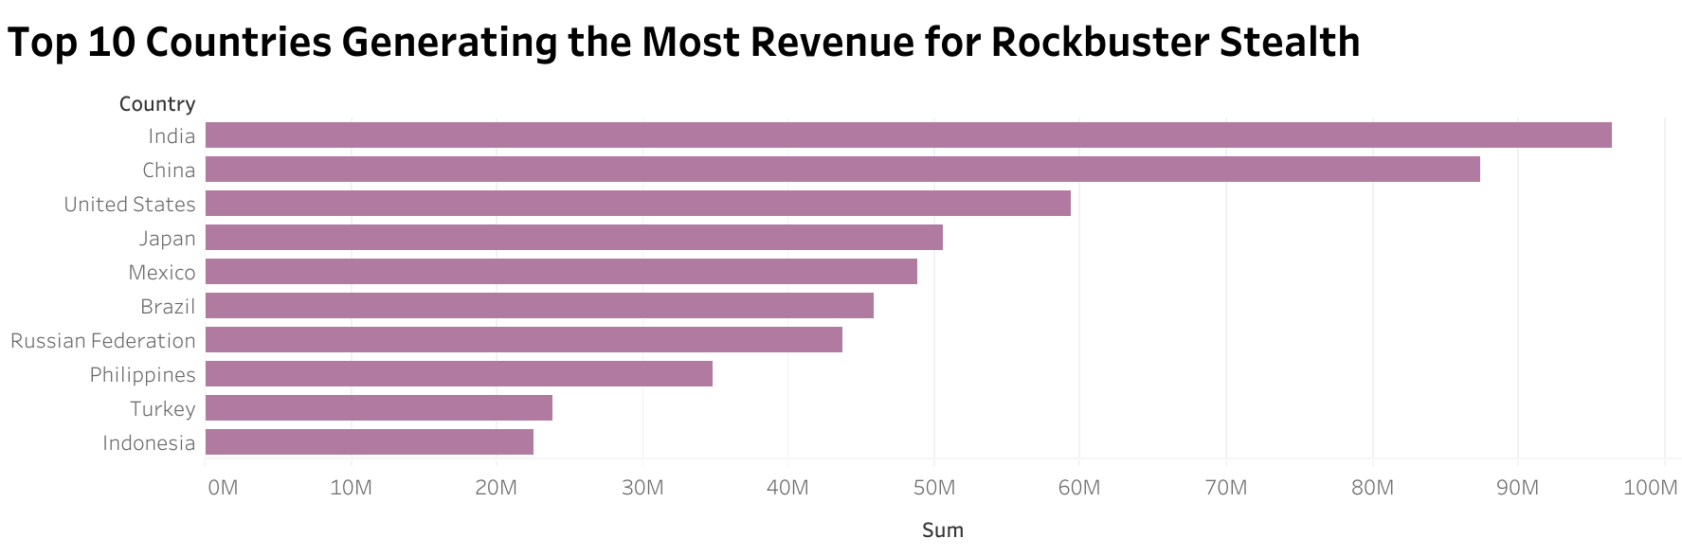

Slide 10
Appendices

Slide 11
Appendix I: List of films generating no revenue
Film list: Ace Goldfinger, African Egg, Agent Truman, Alice Fantasia, Alone Trip, Amelie Hellfighters, Anaconda Confessions, Annie Identity, Anything Savannah, Arizona Bang, Armageddon Lost, Army Flintstones, Bang Kwai, Beach Heartbreakers, Bed Highball, Bedazzled Married, Behavior Runaway, Bilko Anonymous, Bill Others, Blade Polish, Bonnie Holocaust, Boondock Ballroom, Born Spinal, Breakfast Goldfinger, Bubble Grosse, Bucket Brotherhood, Candles Grapes, Canyon Stock, Caper Motions, Casualties Encino, Cause Date, Celebrity Horn, Center Dinosaur, Chamber Italian, Chasing Fight, Cheaper Clyde, Chicago North, Chicken Hellfighters, Chill Luck, Chisum Behavior, Chitty Lock, Cider Desire, Cincinatti Whisperer, Cleopatra Devil, Clones Pinocchio, Clue Grail, Connection Microcosmos, Control Anthem, Core Suit, Craft Outfield, Cranes Reservoir, Creepers Kane, Crow Grease, Dalmations Sweden, Dances None, Dangerous Uptown, Darko Dorado, Darn Forrester, Date Speed, Daughter Madigan, Destination Jerk, Details Packer, Disturbing Scarface, Dogma Family, Donnie Alley, Doom Dancing, Double Wrath, Doubtfire Labyrinth, Dracula Crystal, Drums Dynamite, Duffel Apocalypse, Durham Panky, Dynamite Tarzan, Eagles Panky, Early Home, Earth Vision, Effect Gladiator, Empire Malkovich, Entrapment Satisfaction, Escape Metropolis, Factory Dragon, Family Sweet, Fantasy Troopers, Fidelity Devil, Fight Jawbreaker, Finding Anaconda, Fire Wolves, Flintstones Happiness, Fool Mockingbird, Forrester Comancheros, Forward Temple, Frogmen Breaking, Garden Island, Gathering Calendar, Gentlemen Stage, Ghost Groundhog, Glass Dying, Go Purple, Goldmine Tycoon, Gone Trouble, Graceland Dynamite, Graduate Lord, Grail Frankenstein, Grease Youth, Greedy Roots, Greek Everyone, Gump Date, Gun Bonnie, Gunfighter Mussolini, Guys Falcon, Halloween Nuts, Happiness United, Harry Idaho, Hawk Chill, Holocaust Highball, Holy Tadpole, Hoosiers Birdcage, Horror Reign, Hotel Happiness, Hunter Alter, Hurricane Affair, Idaho Love, Igby Maker, Illusion Amelie, Indian Love, Innocent Usual, Insects Stone, Intolerable Intentions, Invasion Cyclone, Iron Moon, Ishtar Rocketeer, Island Exorcist, Jacket Frisco, Jersey Sassy, Jingle Sagebrush, Jumping Wrath, Jungle Closer, Kentuckian Giant, Kill Brotherhood, Kiss Glory, Kramer Chocolate, Lady Stage, Lawrence Love, Legally Secretary, Lesson Cleopatra, Life Twisted, Lights Deer, Lord Arizona, Lost Bird, Love Suicides, Lovely Jingle, Magnificent Chitty, Maker Gables, Married Go, Microcosmos Paradise, Million Ace, Minority Kiss, Mob Duffel, Monster Spartacus, Monterey Labyrinth, Moon Bunch, Moonwalker Fool, Mother Oleander, Motions Details, Moulin Wake, Mourning Purple, Muscle Bright, Musketeers Wait, Natural Stock, Necklace Outbreak, Neighbors Charade, Newsies Story, Newton Labyrinth, Notting Speakeasy, Nuts Ties, October Submarine, Oklahoma Jumanji, Operation Operation, Oscar Gold, Outbreak Divine, Outfield Massacre, Packer Madigan, Panther Reds, Papi Necklace, Paradise Sabrina, Past Suicides, Paycheck Wait, Peach Innocent, Pet Haunting, Pilot Hoosiers, Pity Bound, Pocus Pulp, Polish Brooklyn, Poseidon Forever, Potluck Mixed, Primary Glass, Queen Luke, Quills Bull, Racer Egg, Raiders Antitrust, Range Moonwalker, Records Zorro, Reign Gentlemen, Reservoir Adaptation, Resurrection Silverado, Rider Caddyshack, Ridgemont Submarine, Road Roxanne, Robbers Joon, Rocky War, Roof Champion, Rules Human, Runaway Tenenbaums, Runner Madigan, Samurai Lion, Satisfaction Confidential, Saturday Lambs, Savannah Town, School Jacket, Seattle Expecations, Secret Groundhog, Shawshank Bubble, Side Ark, Silence Kane, Sinners Atlantis, Sky Miracle, Sleeping Suspects, Slums Duck, Smile Earring, Snatchers Montezuma, Something Duck, Song Hedwig, Sorority Queen, Soup Wisdom, Speed Suit, Spirit Flintstones, Splendor Patton, State Wasteland, Stock Glass, Stone Fire, Straight Hours, Sunrise League, Suspects Quills, Sweet Brotherhood, Tadpole Park, Tequila Past, Theory Mermaid, Thief Pelican, Ties Hunger, Tourist Pelican, Tracy Cider, Translation Summer, Treasure Command, Treatment Jekyll, Trojan Tomorrow, Trouble Date, Tuxedo Mile, Uncut Suicides, Unforgiven Zoolander, Uptown Young, Valley Packer, Vampire Whale, Velvet Terminator, Virgin Daisy, Virtual Spoilers, Volcano Texas, Wagon Jaws, Walls Artist, Watership Frontier, Whale Bikini, Window Side, Wonderful Drop, Words Hunter, Working Microcosmos, Wrath Mile

Slide 12
Appendix II: List of countries customers are based in.
Country list: India, China, United States, Japan, Mexico, Brazil, Russian Federation, Philippines, Turkey, Indonesia, Argentina, Nigeria, South Africa, Taiwan, United Kingdom., Poland, Iran, Germany, Italy, Venezuela, Egypt, Colombia, Ukraine, Vietnam, Spain, Canada, South Korea, Pakistan, Netherlands, Saudi Arabia, Israel, France, Yemen, Peru, Dominican Republic, Bangladesh, Thailand, Algeria, Chile, Malaysia, Mozambique, Switzerland, Ecuador, Paraguay, Austria, United Arab Emirates, Morocco, Tanzania, Myanmar, Bulgaria, Cameroon, Cambodia, Congo, The Democratic Republic of the, Sudan, Romania, Latvia, Yugoslavia, Puerto Rico, Kazakstan, Greece, Bolivia, Kenya, French Polynesia, Angola, Belarus, Oman, Azerbaijan, Hungary, American Samoa, Armenia, Sri Lanka, French Guiana, Sweden, Faroe Islands, Ethiopia, Bahrain, Czech Republic, Lithuania, Turkmenistan, Tunisia, Virgin Islands, U.S., Malawi, Chad, Afghanistan, Greenland, Moldova, Gambia, Holy See (Vatican City State), Estonia, Slovakia, North Korea, Nauru, Liechtenstein, Senegal, Zambia, Hong Kong, Kuwait, Madagascar, Runion, Saint Vincent and the Grenadines, Tuvalu, Finland, Iraq, Anguilla, Brunei, Tonga, Nepal, New Zealand

Slide 13
Appendix III: Descriptive Stats for Numerical Variables
variable | min | max | avg
release_year | 2006 | 2006 | 2006
rental_duration (minutes) | 3 | 7 | 4.985
rental_rate | 0.99 | 4.99 | 2.98
length (minutes) | 46 | 185 | 115.272
replacement_cost (USD) | $ 9.99 | $ 29.99 | $ 19.98

Slide 14
Appendix IV: Descriptive Stats for Non-numerical Variables
language | modal value
language_id | 1
rating | PG-13
special_features | {Trailers,Commentaries,"Behind the Scenes"}
(film_imbd | {null}
store_id | 1
activebool | 1
active | 1

Slide 15
Appendix V: Descriptive Stats for Dates
variable | min | max | mode
last_update | 5/26/13 14:50 | 5/26/13 14:50 | 5/26/13 14:50
create_date | 2/14/06 | 2/14/06 | 2/14/06

Slide 16
Appendix VI: Descriptive Stats Other Notes
Multiple Modes – SQL returns a random value in this set as the mode first_name has multiple modes.
Variables with only unique values – SQL returns a random value as the mode. Customer_id, email, last_name, & address_id have only unique values.

Slide 17
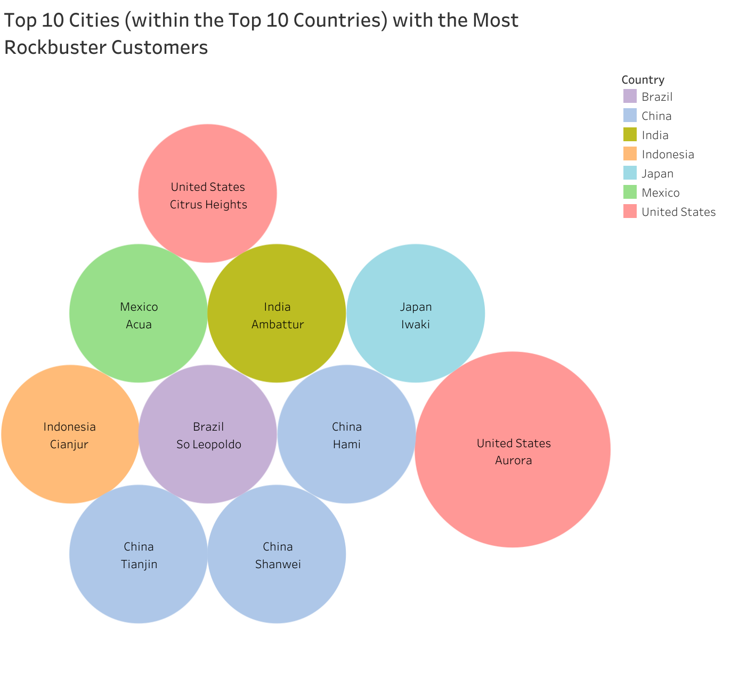
Appendix VII: Top 10 Cities with the Most Rockbuster Customers

Slide 18
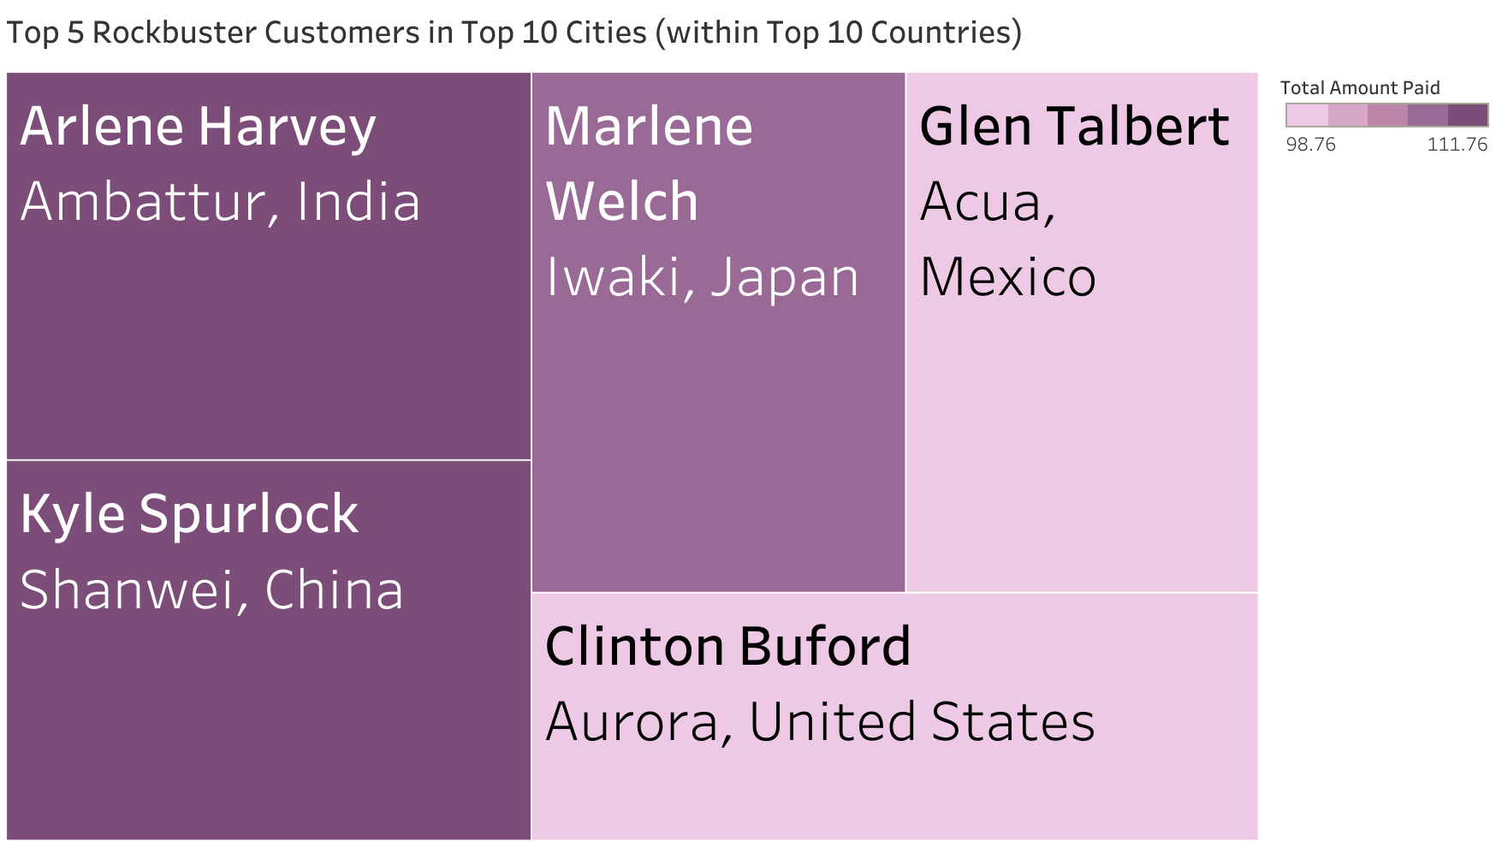
Appendix VIII: Top 5 Rockbuster Customers in Top 10 Cities (within Top 10 Countries)

Slide 19
Link to Tableau Visualizations
https://public.tableau.com/shared/4XYMQBH2N?:display_count=n&:origin=viz_share_link

Slide 20

Thank you

